Slide 1
INTRODUCTION TO DIGITAL ELECTRONICS
Digital electronics represent signals by discrete bands of analog levels, rather than by a continuous range. All levels within a band represent the same signal state. Relatively small changes to the analog signal levels due to manufacturing tolerance, signal attenuation or parasitic noise do not leave the discrete envelope, and as a result are ignored by signal state sensing circuitry.
In most cases the number of these states is two, and they are represented by two voltage bands: one near a reference value (typically termed as "ground" or zero volts) and a value near the supply voltage, corresponding to the "false" ("0") and "true" ("1") values of the Boolean Domain respectively.
Digital techniques are useful because it is easier to get an electronic device to switch into one of a number of known states than to accurately reproduce a continuous range of values.
Digital electronic circuits are usually made from large assemblies of Logic Gates, simple electronic representations of Boolean Logic Functions.

Slide 2

One advantage of digital circuits when compared to analog circuits is signals represented digitally can be transmitted without degradation due to noise. For example, a continuous audio signal, transmitted as a sequence of 1s and 0s, can be reconstructed without error provided the noise picked up in transmission is not enough to prevent identification of the 1s and 0s. An hour of music can be stored on a compact disc using about 6 billion binary digits.
In a digital system, a more precise representation of a signal can be obtained by using more binary digits to represent it. While this requires more digital circuits to process the signals, each digit is handled by the same kind of hardware. In an analog system, additional resolution requires fundamental improvements in the linearity and noise characteristics of each step of the signal chain.
Computer-controlled digital systems can be controlled by software, allowing new functions to be added without changing hardware. Often this can be done outside of the factory by updating the product's software. So, the product's design errors can be corrected after the product is in a customer's hands.
Information storage can be easier in digital systems than in analog ones. The noise-immunity of digital systems permits data to be stored and retrieved without degradation. In an analog system, noise from aging and wear degrade the information stored. In a digital system, as long as the total noise is below a certain level, the information can be recovered perfectly.

Slide 3
Logic gates process signals which represent true or false. Normally the positive supply voltage +Vs represents true and 0V represents false.
A logic gate is an idealized or physical device implementing a Boolean function, that is, it performs a logical operation on one or more logic inputs and produces a single logic output. Depending on the context, the term may refer to an ideal logic gate.
LOGIC GATES POSITIVE LOGIC IMPLEMENTATION
TRUE | FALSE
1 | 0
High | Low
+Vs | 0V
ON | OFF

Slide 4
LOGIC GATES NEGATIVE LOGIC IMPLEMENTATION
TRUE | FALSE
0 | 1
Low | High
0V | +Vs
OFF | ON

Slide 5

A truth table shows how a logic circuit's output responds to various combinations of the inputs, using logic 1 for true and logic 0 for false. All permutations of the inputs are listed on the left, and the output of the circuit is listed on the right. The desired output can be achieved by a combination of logic gates. Truth tables help understand the behavior of logic gates.
They show how the input(s) of a logic gate relate to its output(s).
The gate input(s) are shown in the left column(s) of the table with all the different possible input combinations. This is normally done by making the inputs count up in binary.
The gate output(s) are shown in the right hand side column.

Slide 6
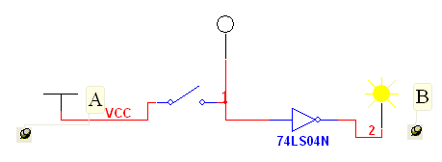
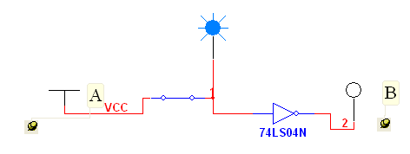
Inverter
In digital logic, an Inverter or NOT gate is a Logic Gate which implements Logical Negation. As the name implies, inverter will invert the number entered. If you enter ”0“, you will get a ”1“ on its output, and if you enter a ”1“, you will get a ”0“ on its output. The inverter symbol is shown in the Figure. Inverter gate is also known as NOT and its output is Y = ~A or A’. IC NUMBER IS 7404.
A | B=A’
0 | 1
1 | 0

Slide 7

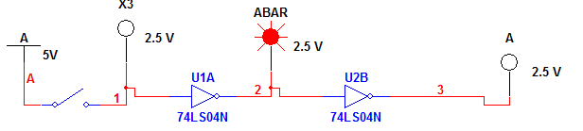
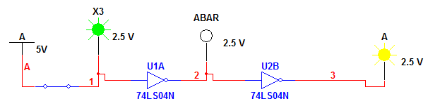
In digital logic, Buffer is a Logic Gate which transfers the input to the output. It is constructed by connecting Two Inverters in Series.
A | B=A
0 | 0
1 | 1

Slide 8
AND GATE
The AND gate is a digital logic gate that implements the logic function C = A.B where A and B are the inputs and C is the Output. It behaves according to the Truth Table ,A HIGH output (1) results only if both the inputs to the AND gate are HIGH (1). If neither or only one input to the AND gate is HIGH, a LOW output results. IC number is 7408.
A | B | C=A.B
0 | 0 | 0
0 | 1 | 0
1 | 0 | 0
1 | 1 | 1

Slide 9
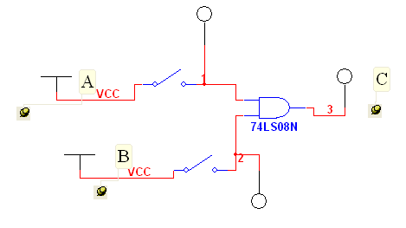
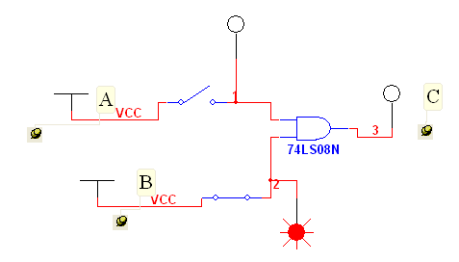
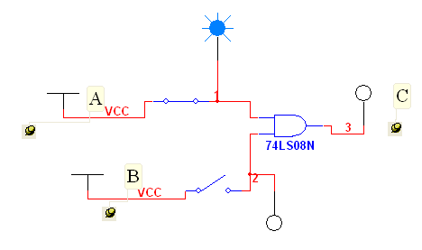
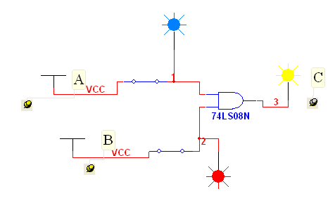

Slide 10
NAND GATE
The ”N“ letter on NAND stands for NOT, meaning that NAND logic gate is an AND gate with an inverter attached. So, its output is the opposite from AND. The Negated AND or NAND gate is the opposite of the digital AND Gate, and behaves in a manner that corresponds to the opposite of AND gate A LOW output results only if both the inputs to the gate are HIGH. If one or both inputs are LOW, a HIGH output results. IC Number is 7400
A | B | C=(A.B)’
0 | 0 | 1
0 | 1 | 1
1 | 0 | 1
1 | 1 | 0

Slide 11
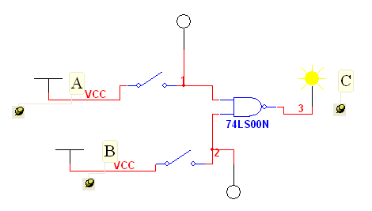
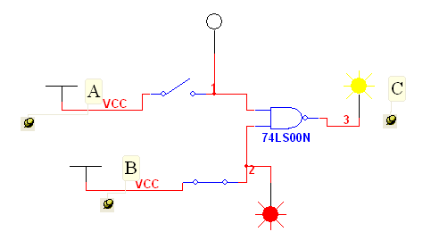

Slide 12
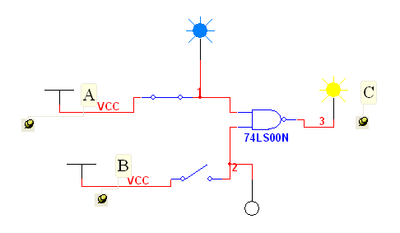
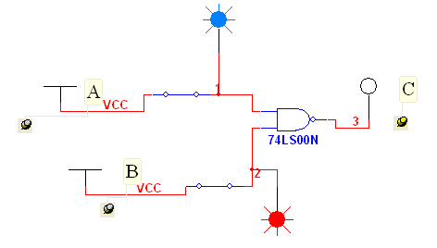

Slide 13
OR GATE
The OR gate is a digital logic gate which behaves according to the truth table, A HIGH output (1) results if one or both the inputs to the gate are HIGH (1). If neither input is HIGH, a LOW output (0) results. In another sense, the function of OR effectively finds the maximum between two binary digits, just as the complementary AND function finds the minimum. OR logic gate can be summarized by the formula Y = A + B. IC Number is 7432
A | B | Y=A+B
0 | 0 | 0
0 | 1 | 1
1 | 0 | 1
1 | 1 | 1

Slide 14
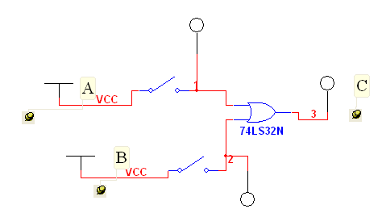


Slide 15
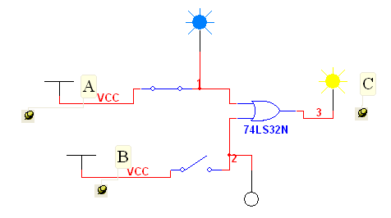
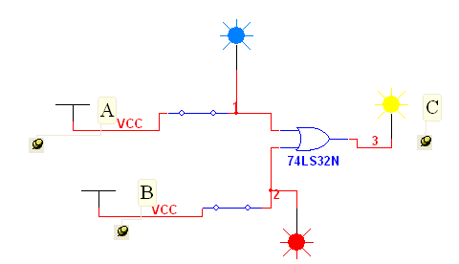

Slide 16
NOR GATE
The NOR gate is a digital logic gate which behaves according to the truth table ,A HIGH output (1) results if both the inputs to the gate are LOW (0). If one or both input is HIGH (1), a LOW output (0) results. NOR is the result of the negation of the OR operator. IC Number is 7402.
A | B | Y=(A+B)’
0 | 0 | 1
0 | 1 | 0
1 | 0 | 0
1 | 1 | 0

Slide 17
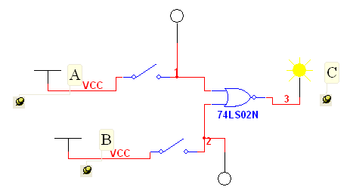
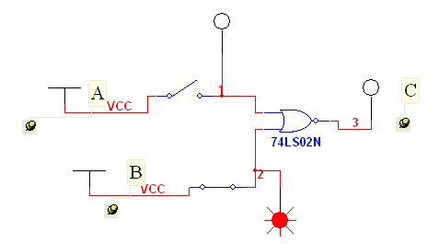

Slide 18
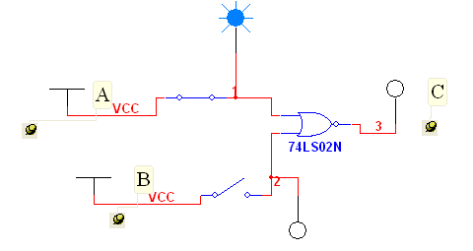
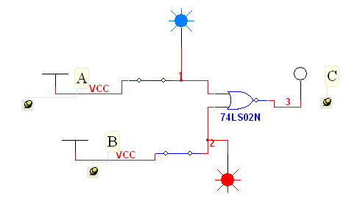

Slide 19
XOR GATE
XOR stands for exclusive OR. XOR gate compares two values and if they are different its output will be “1.” XOR operation is represented by the symbol ⊕. So Y = A ⊕ B. IC Number is 7486.
A | B | Y=A⊕B
0 | 0 | 0
0 | 1 | 1
1 | 0 | 1
1 | 1 | 0

Slide 20
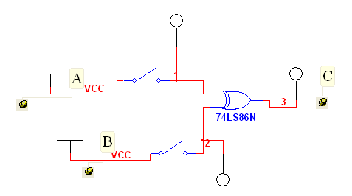


Slide 21
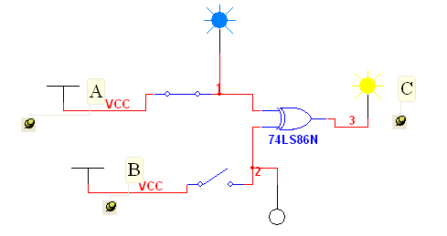
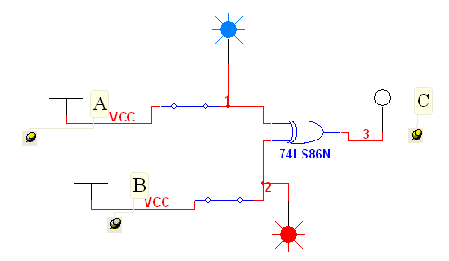

Slide 22
XNOR GATE
XNOR stands for exclusive NOR and is an XOR gate with its output inverted. So, its output is at ”1“ when the inputs have the same value and ”0“ when they are different. XNOR operation is represented by the symbol (·). So Y = A (·) B. IC Number is 747266.
A | B | Y=A(·)B
0 | 0 | 1
0 | 1 | 0
1 | 0 | 0
1 | 1 | 1

Slide 23
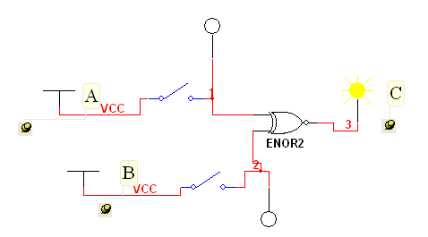
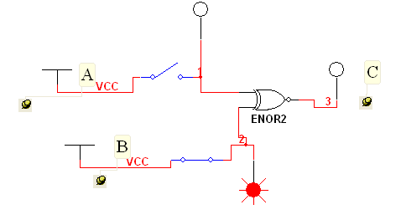

Slide 24
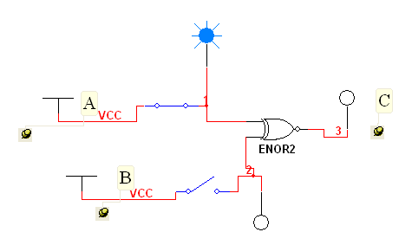
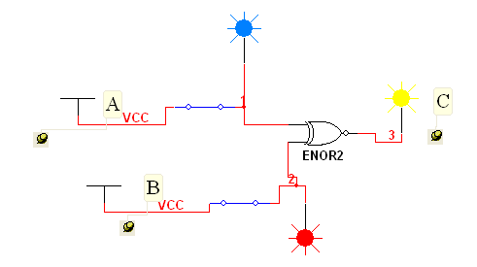

Slide 25

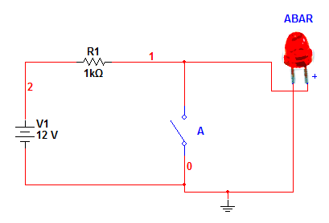
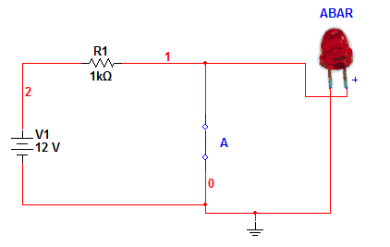
INVERTER

Slide 26

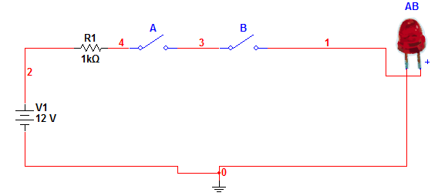
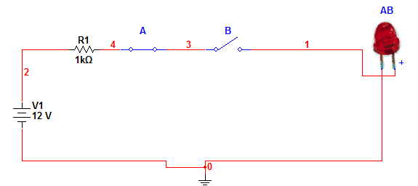
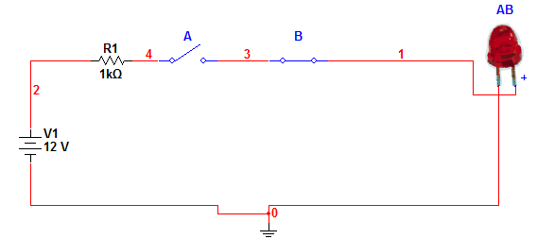
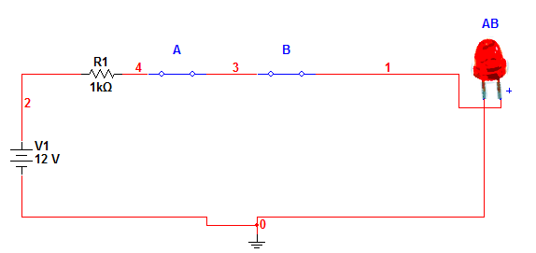

Slide 27

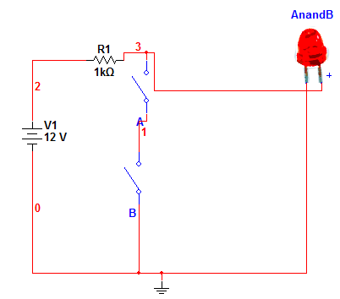
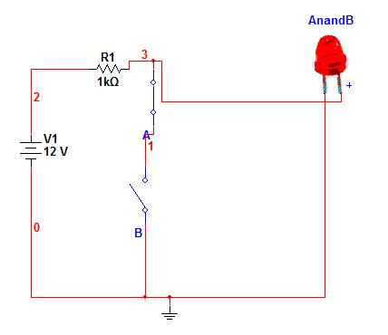
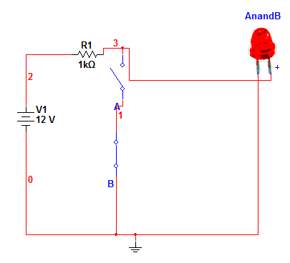
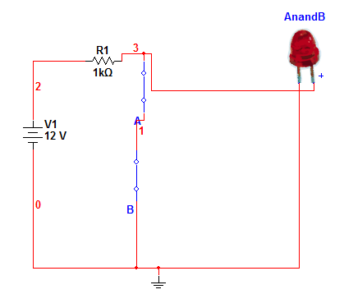

Slide 28

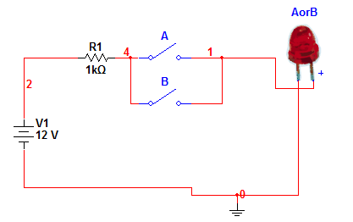
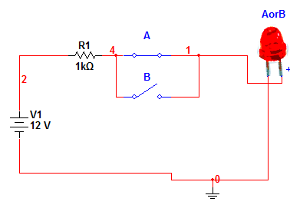
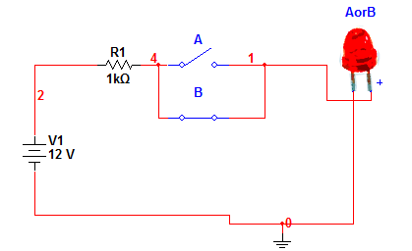
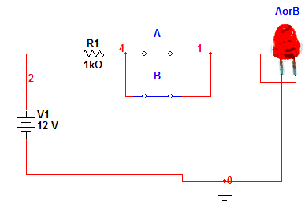

Slide 29

